Slide 1
Building Mobile Applications with JQuery
Rick Mason, MSU Advancement

Slide 2
Setting up the emulator
Android emulator install ;<(
Need to download packages after install
Then configure a virtual device each time
http://www.android.com
Apple experience is easier but costs $100 and you have to own a Mac

Slide 3
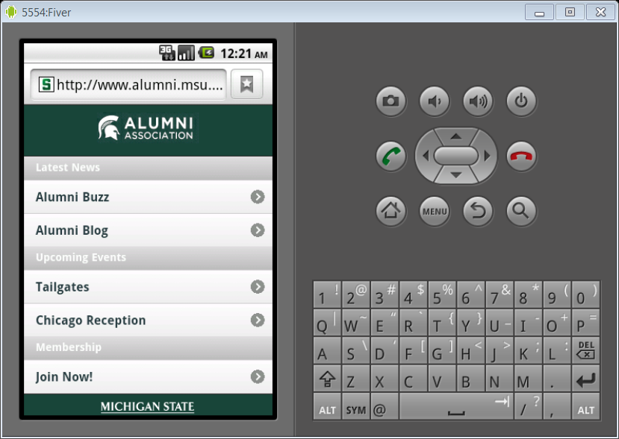

Slide 4
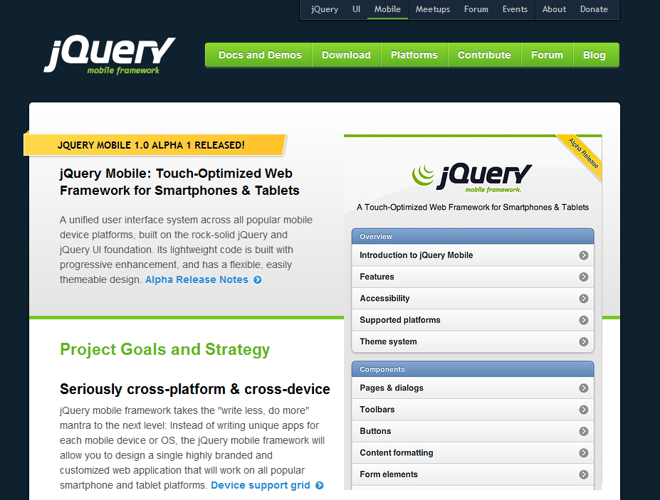
JQuery Mobile

Slide 5
Required libraries
Load in this order:
jquery.mobile-1.0a1.min.css
jquery-1.4.3.min.js
jquery.mobile-1.0a1.min.js

Slide 6
Reference Sample Page
To the code:

Slide 7
Calling another page within
<a href=“#Communications" data-role="button">Communications</a>
Button in turn calls a div wrapping the new page:
<div data-role="page" id="Communications">

Slide 8
Demo page within a page

Slide 9
Styling the page
Data-theme’s A through E
Theme roller coming that will let you style
Or you can create in CSS a theme ‘F
Side by side
UI-block A and B classes

Slide 10
Demo styling

Slide 11
Breaking out of single pages
Add rel=“external”
Example:
<a href=“lookup.cfm?begin=a&end=b” rel=“external” data-role=“button”>A – B</a>

Slide 12
Putting it all together
User selects first letter of last name
Next page he selects the person
Last page displays persons information

Slide 13
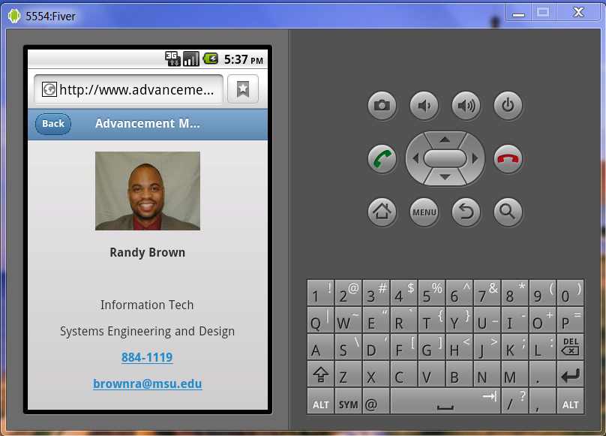
Demo of application

Slide 14
Drawbacks
JQuery Mobile is an alpha!
That means it doesn’t work on all phones
Goal is to support newer iPhones, Droids and Blackberry’s
You may need to manage release dates on software you develop using it

Slide 15
Pluses:
Easiest way to build mobile applications
Builds on JQuery and CSS knowledge
Docs are limited but good
Large community of developers for a new project
It’s fun!

Slide 16
Questions?
Rick Mason, masonri@msu.edu

