Slide 1
Twitter Bootstrap
Rick Mason

Slide 2

All houses were custom built on site

Slide 3
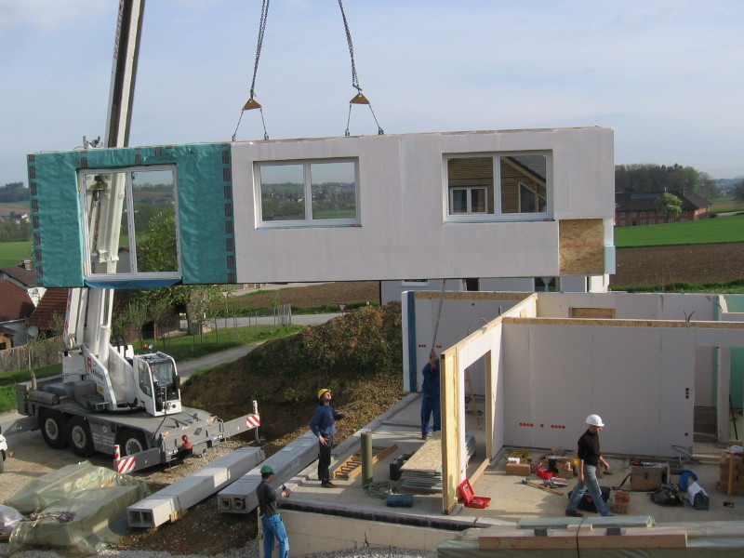
Then someone got the idea for prefab

Slide 4
Twitter Bootstrap does the same for web sites
It’s a toolkit designed to kick start web designs
Lets non-designers easily build good looking sites
Combination of HTML, CSS and JavaScript
Twitter built it for themselves and then open sourced it

Slide 5
Bootstrap feature set
Built on LESS
Complete style guide docs
Fully responsive design
Small footprint, only 10 kb zipped
Support for IE-7 and up
Custom jQuery plug-ins
Dozens of components
HTML5 ready

Slide 6
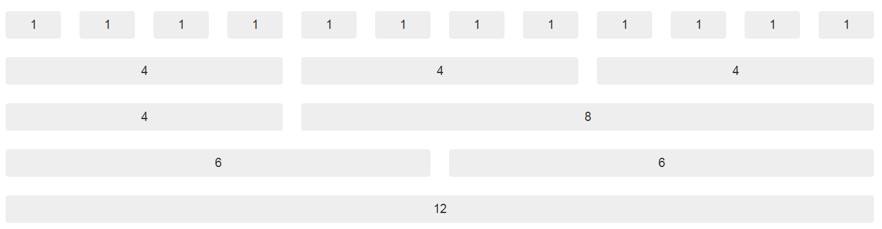
Bootstrap is built on a 12 column grid

Slide 7
Off to the code samples

Slide 8
A look at forms
Vertical (default)
Horizontal
Inline
Search

Slide 9
A look at form code

Slide 10
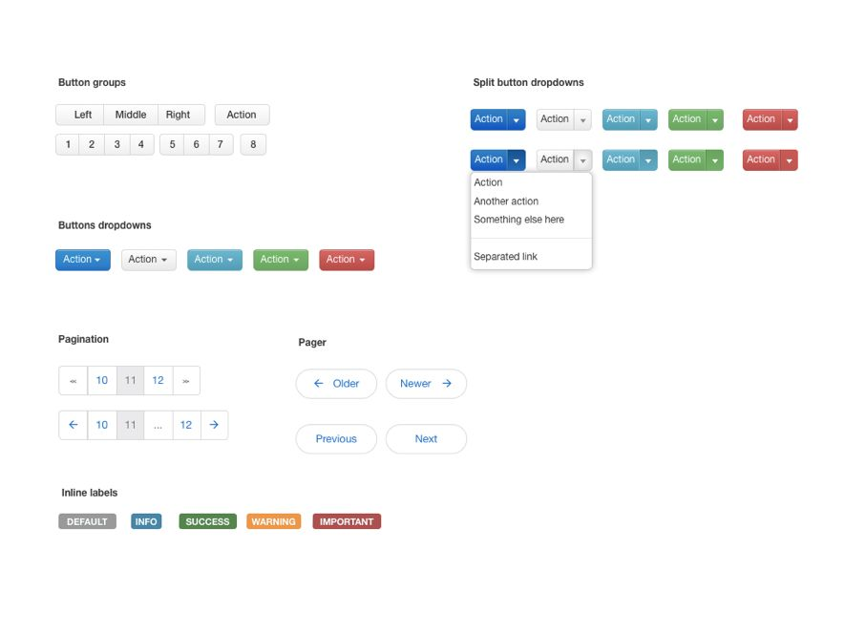
Buttons and alert messages

Slide 11
A look at buttons and alerts code

Slide 12
Tables in Bootstrap
Default – No styles
Basic – Just lines between rows
Bordered – Rounds corners and adds an outer border
Zebra-Stripe – Adds background color to odd numbered rows
Condensed – Cuts vertical padding in half

Slide 13
To the table code examples

Slide 14
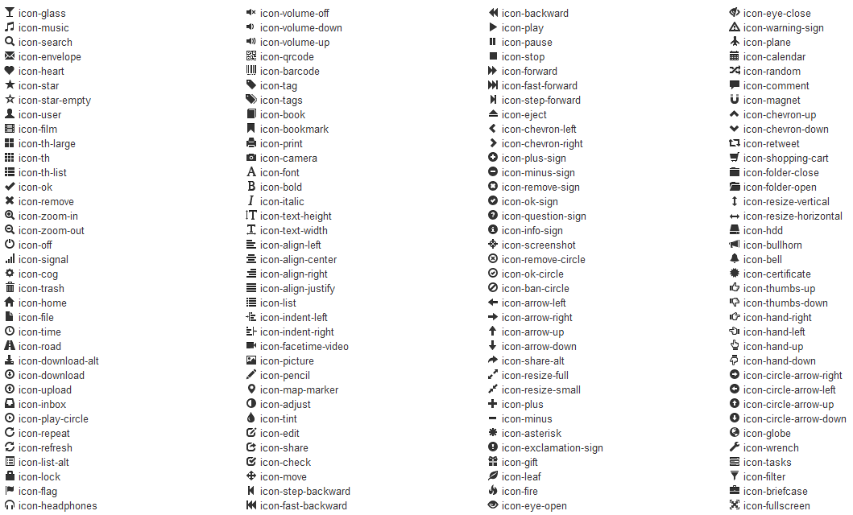
Icons and Progress bars

Slide 15
Icons and Progress bars code

Slide 16
Understanding LESS
Treat colors and pixels as variables
All variables in .LESS file
Change the file and then compile
Supports mixins for reusable snippets of code

Slide 17
Compiling with LESS
1. Use node.js package manager npm
2. Use less.js and put path in <head>
<link rel="stylesheet/less" href="/path/to/bootstrap.less"> <script src="/path/to/less.js"></script>
3. Use unofficial Mac app
http://incident57.com/less/ It watches directory and compiles every time you save the file $20
4. New (and free) for PC and Mac
http://wearekiss.com/simpless

Slide 18
What I left out
Support for breadcrumbs
Pagination
Badges
Thumbnails
Support for slide shows with Carousel
Accordions, popovers and tooltips

Slide 19
What’s missing
Namespaces
Too easy to conflict with other libraries using same names

Slide 20
Third party add ins for Bootstrap
Pretty buttons - http://charliepark.org/bootstrap_buttons/
Calendar - http://www.calendarandti.me/
IE-6 support - http://bit.ly/zj3L66
Boots – Auto build installs http://projects.jga.me/boots/
Form Builder - http://bootstrap-forms.heroku.com/
Free themes - http://bootswatch.com/
Bootswatch – auto change color http://bootswatch.com/
Custom buttons - http://bit.ly/xbFZe6
Kickstrap – TBS Fork http://bit.ly/GZJWZ0
Lavish – Color theme builder http://www.lavishbootstrap.com/
Utility Classes - http://yfrog.com/z/kjr43wp

Slide 21
Adobe and Bootstrap
Brackets a code editor built from Bootstrap and JavaScript
Demo

Slide 22
Questions?
                Rick Mason
                rmason@acd.net

